Slide 1
BarnOwl V11
FULLY INTEGRATED GOVERNANCE, RISK MANAGEMENT, COMPLIANCE AND AUDIT SOFTWARE
February 2023

Slide 2
BarnOwl V11
BarnOwl’s eagerly awaited, state of the art, new web-based version has just been released
Version 11 offers our clients a fresh, modern and simplified web-based user interface utilising the latest web-based technology
Version 11, will over time, incorporate much of BarnOwl’s extensive desktop app ‘rich’ functionality including built-in reporting
V11.1 (released Feb 2023) essentially replaces the existing BarnOwl Lite interface with a new modern interface
We are very excited to announce the release of version 11

Slide 3
BarnOwl V11 Roadmap
V11.1 (BarnOwl Web risk management) (February 2023)
V11.2 (BarnOwl Web voting (RCSAs, Surveys, Questionnaires)) (mid 2023)
V11.3 (BarnOwl Web reporting) (end 2023)
V11.4 (Internet facing Votes, Surveys & Questionnaires) (end 2023)
Administrative tasks will remain in the desktop app
Standard reports will remain in the desktop app
Standard Power BI and SSRS reporting (*)
Advanced Power BI and SSRS reporting (**)
(*) included as part of the standard package on request – generated directly from the BarnOwl database
(**) additional purchased license – generated from the BarnOwl data warehouse

Slide 4
Why upgrade to BarnOwl V11
Upgrade BarnOwl to the latest web-based technology
Modern, clean-cut user interface
Simplified navigation
Standardised look & feel across all registers and forms (pages)
Risk on a page simplifies risk taxonomy
Performance enhancements
Functional improvements
Minor bug fixes

Slide 5
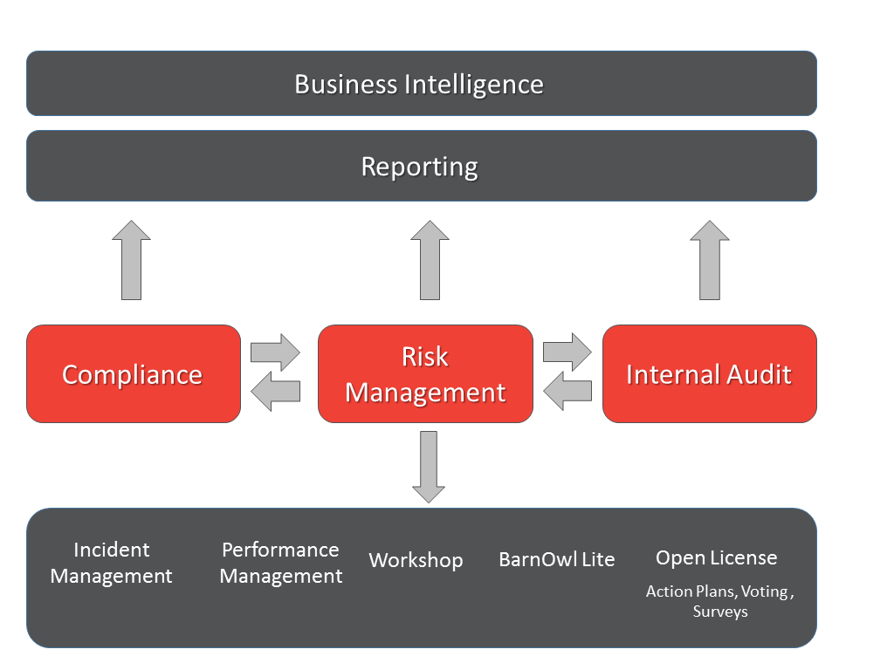
Recap - BarnOwl integrated modules

Slide 6
What does BarnOwl V11.1 mean for me?
V11.1 essentially replaces the existing web-based BarnOwl Lite interface with a new modern interface utilising the latest web-based technology.
No changes have been made to the BarnOwl Rich desktop app. BarnOwl Rich will still work exactly the same way.
A web-based Lite license is included with every Rich license. Therefore a Rich user has the option of using the web-based interface or the desktop Rich interface or both interfaces for certain functions (e.g. reports in Rich, capture / maintain risks in Lite).
The advantage of the new V11.1 web-based interface is that it is:
easy to navigate
easy to capture and maintain all risk related data (risk on a page)
performs well (i.e. is fast) over a slow network such as a VPN
V11.3 (scheduled late 2023) will include built-in reports
Version 11.1 incorporates bug fixes / minor enhancements so it is advisable to upgrade to V11.1.
The current advantage of the Rich desktop app is that it includes:
built-in reporting
drill-down registers whereby you can expand a register (e.g. the risk register) to see detailed child registers (contributing factors, controls, KIs, action plans etc.). However this is also what makes BarnOwl Rich appear complex
administrative functions such as applying of processes, risk templates, votes etc.

Slide 7
Features of BarnOwl V11.1
Landing page giving the user a heads up of work items (Action plans, Votes, Key Indicators, RAPs) (v10)
New look & feel organisational structure (option in SMC to include processes)
Registers (Clean look & feel with column filtering, field selection, sorting, drag & drop columns, grouping, favourite views, global search (across multiple fields))
Objective Register
Risk Register (focal point)
My Key Indicators
My Action plans
Incident registers
My Voting
Register menus:
Actions (Link record, Unlink record)
This View (Clear filters, Wrap all, Unwrap all, Reset, Export to Excel, Export to PDF, Add to My BarnOwl)
Favourite View (New, Update, Edit, Delete, manage, Select)

Slide 8
Features of BarnOwl V11.1 (continued)
Link / Unlink:
Easy to search library and link an existing record to a unit or create a new library record
Easy to unlink a record from a unit
Easy to maintain library records (new, merge, delete with administrator permissions) (v10)
On loading a form / page:
Logical menu options: Action (Link, Save&Close, Save, Unlink), View (History, Model, Linked)
Logical tabs: Library record, Linked objects, Unit detail, Ratings, Owners, Custom fields
Risk Structure:
Risk on a page with easy navigation to all associated objects (objectives, controls, contributing factors, action plans, key indicators, incidents, parent risks, child risks)
Context sensitive menus (including collapse all / expand all)

Slide 9
In summary, upgrading to BarnOwl V11.1
replaces the existing BarnOwl Lite interface with BarnOwl’s new web interface which is modern, user friendly and performs well over slow networks such as VPN.
addresses minor bug fixes / enhancements.
has no effect on how you currently use the BarnOwl Rich desktop app (i.e. no changes have been made to the Rich desktop app).
will enable users to transition to the new BarnOwl web app in preference to the BarnOwl Rich desktop especially when V11.3 is released (scheduled for late 2023) with built-in reporting. Administrative tasks will however remain in BarnOwl Rich
will include standard Power BI and SSRS reports on request (are now included as part of the standard package – generated directly from the BarnOwl database)
NB: Advanced Power BI and SSRS reporting (additional purchased license – generated from the BarnOwl data warehouse)

Slide 10
Latest web-based Technology

Slide 11
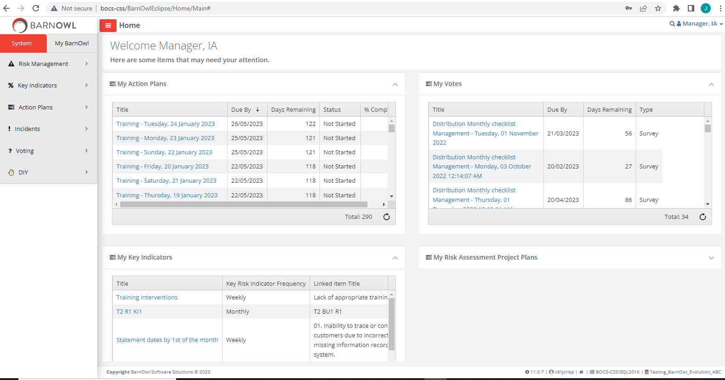
Landing page (v10)

Slide 12
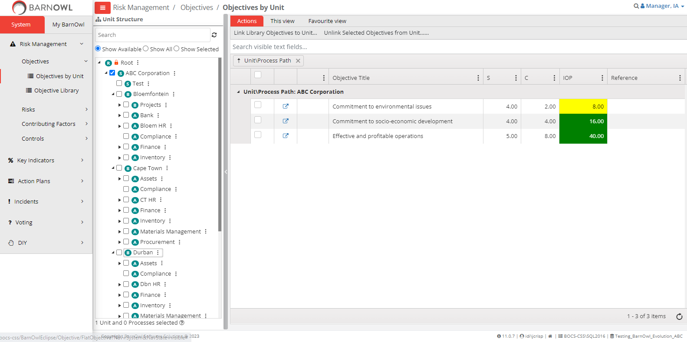
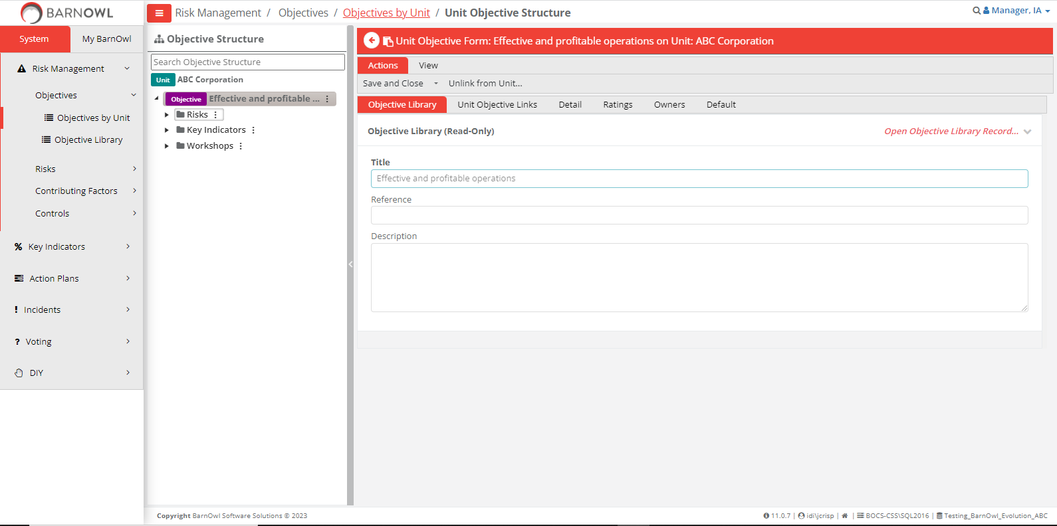
Unit Objective Register

Slide 13
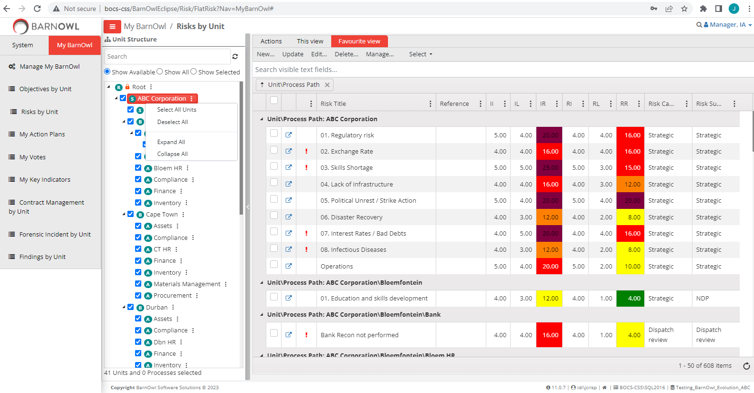
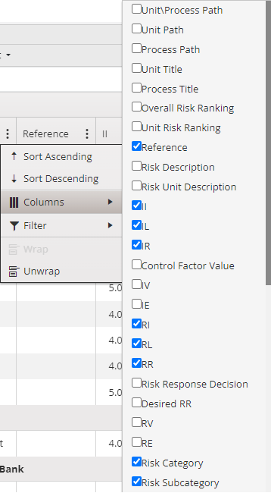
Unit Risk Register

Slide 14
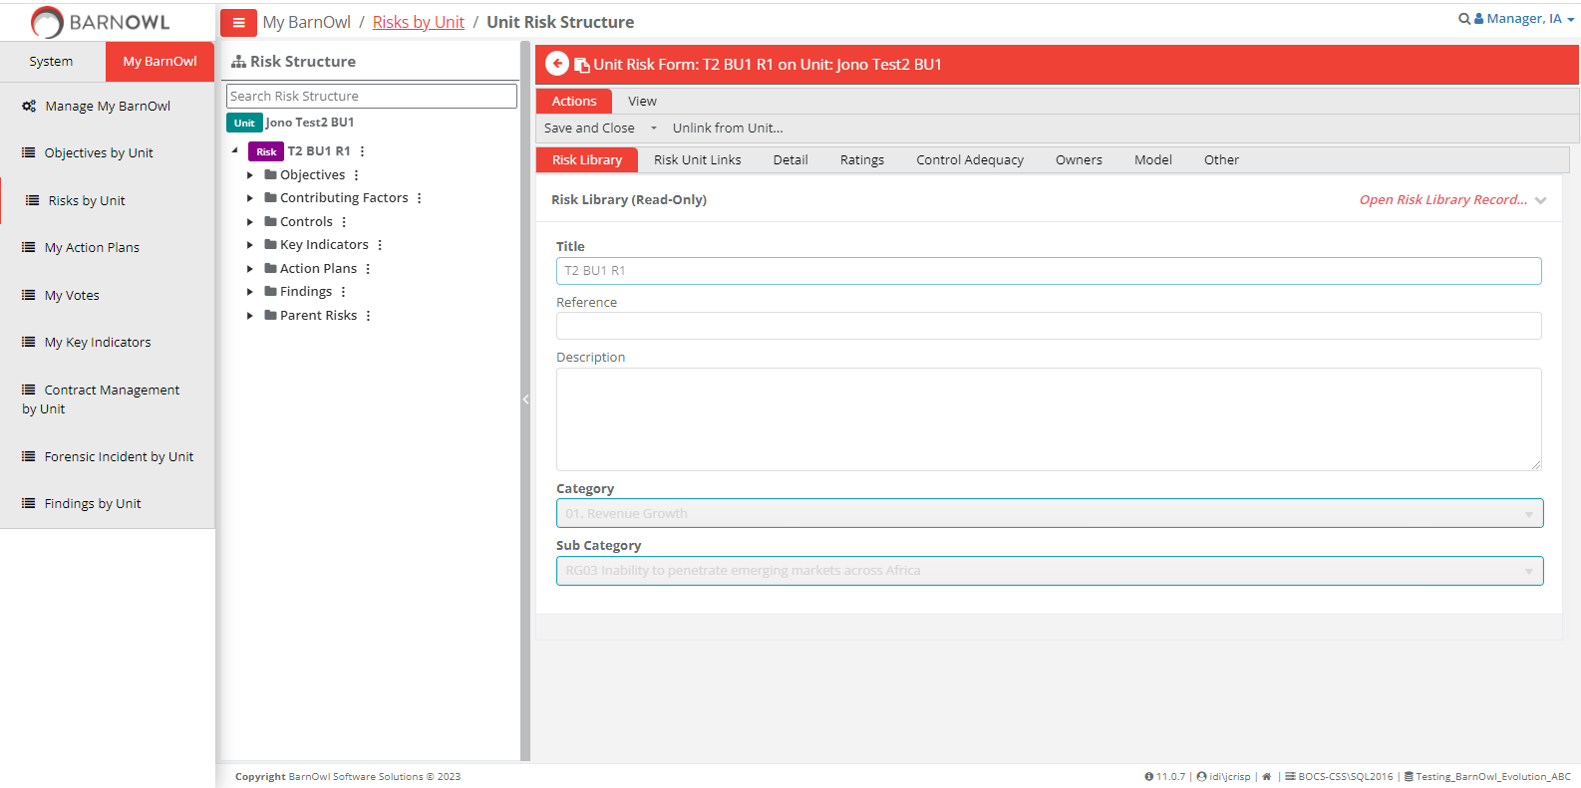
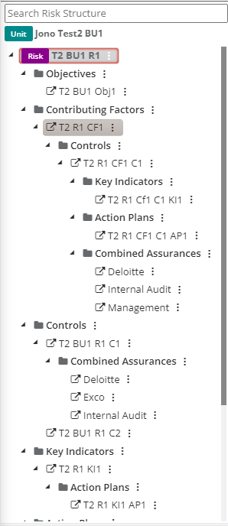
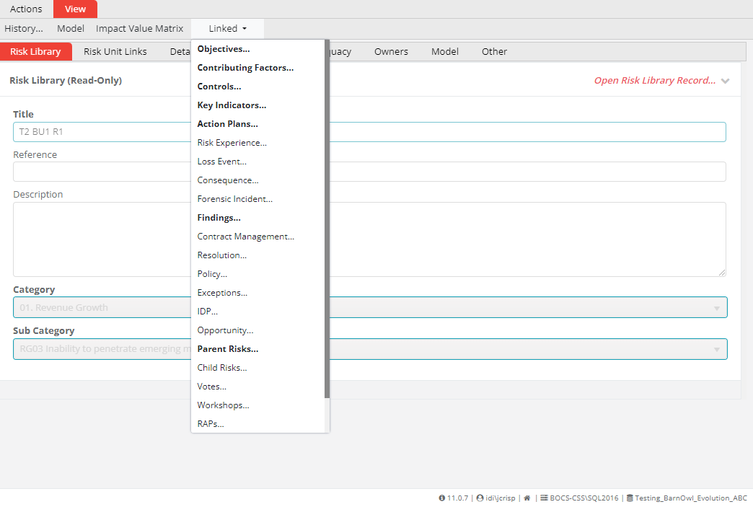
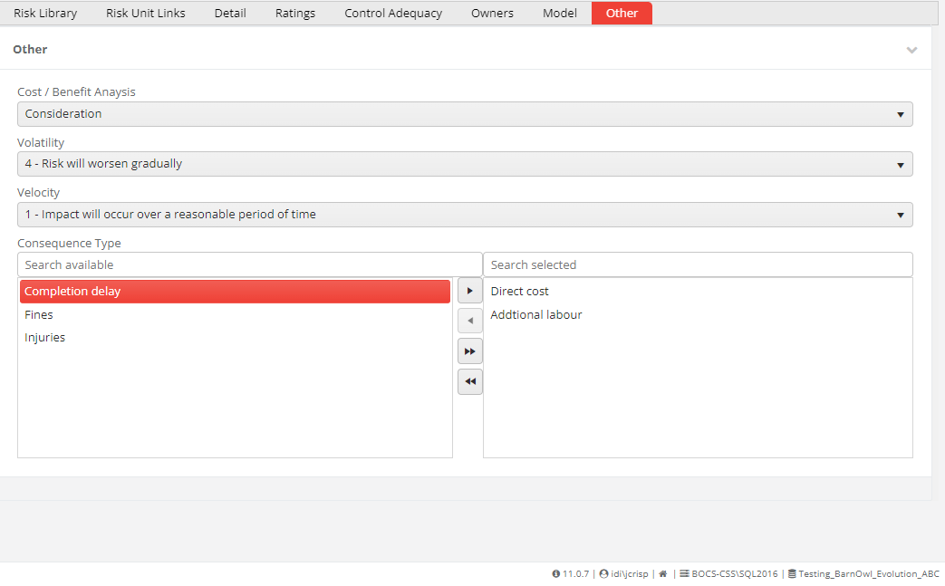
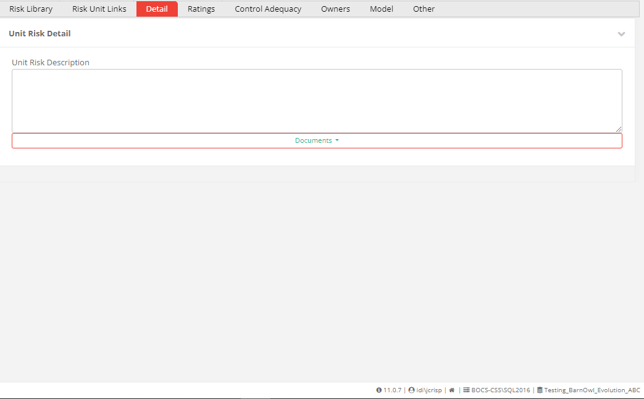
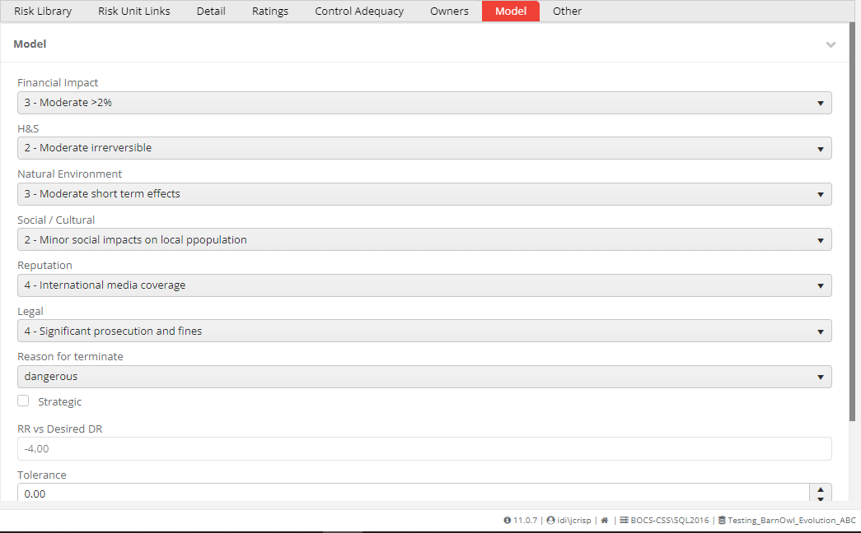
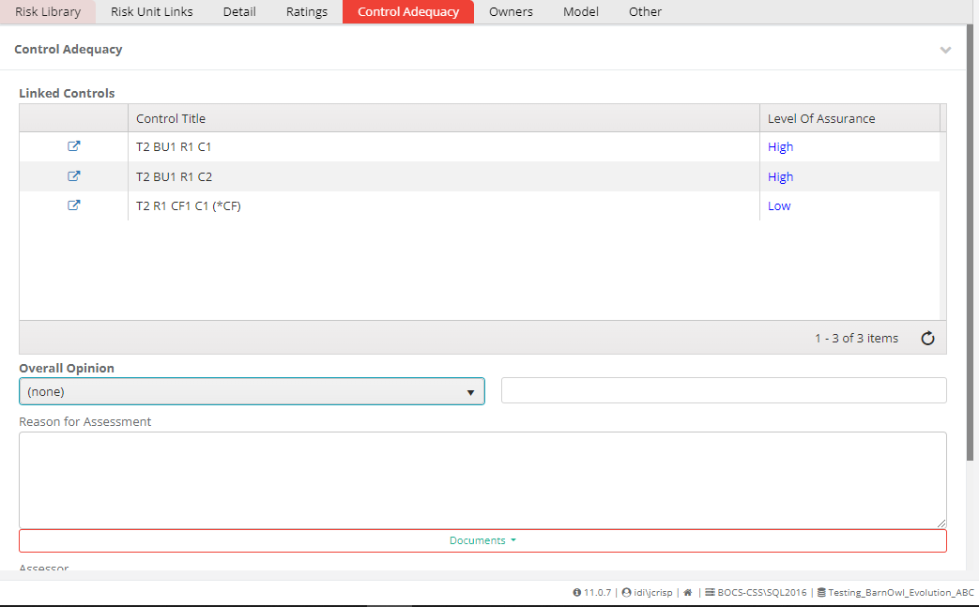
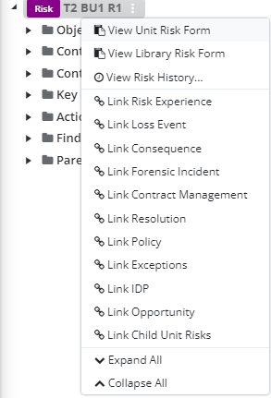
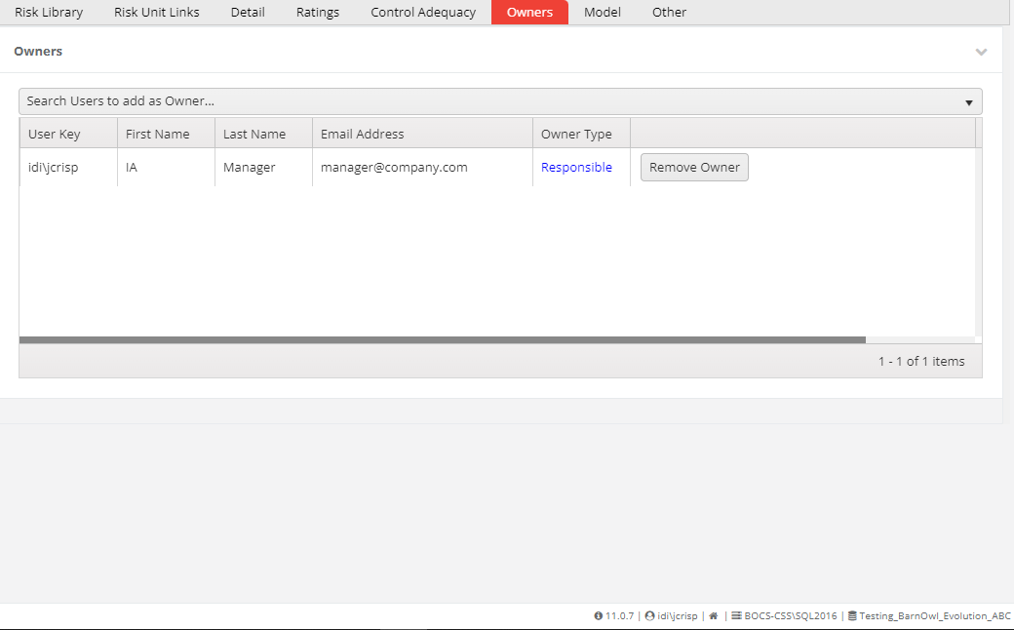
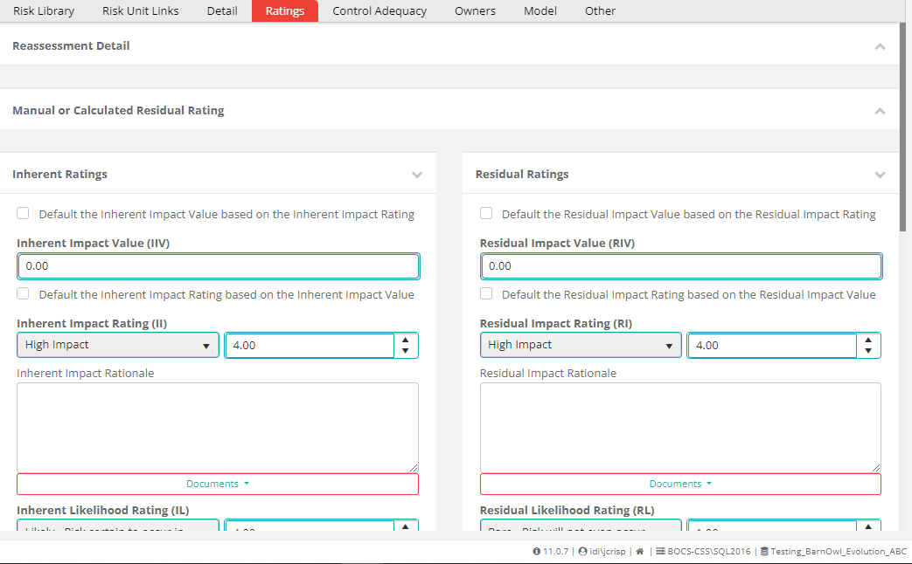
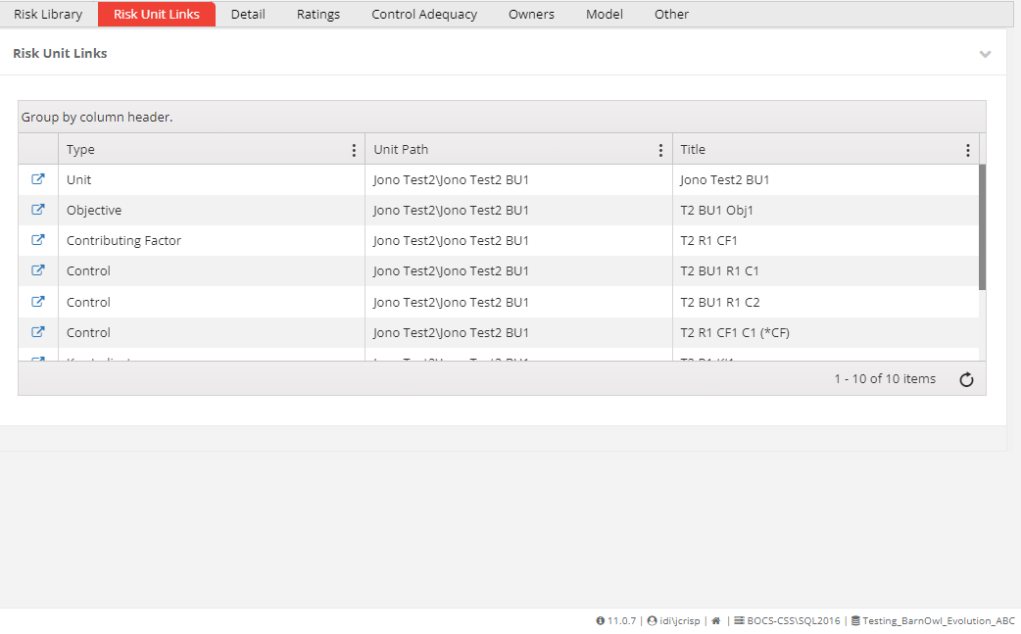
Unit Risk Form

Slide 15
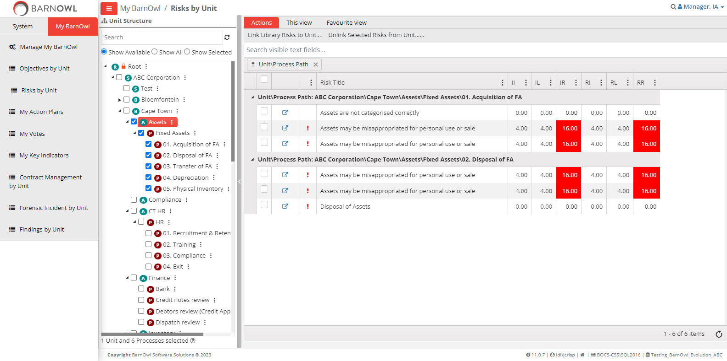
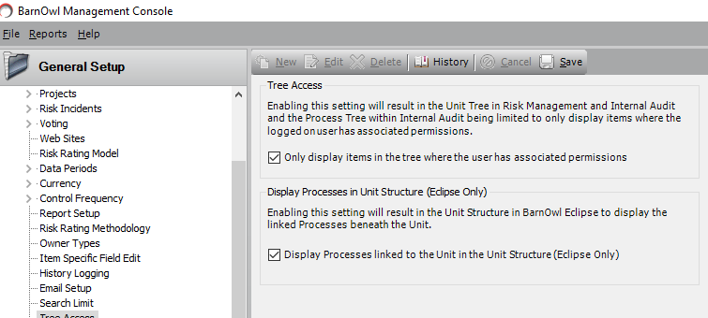
Organisational structure showing units and processes

Slide 16
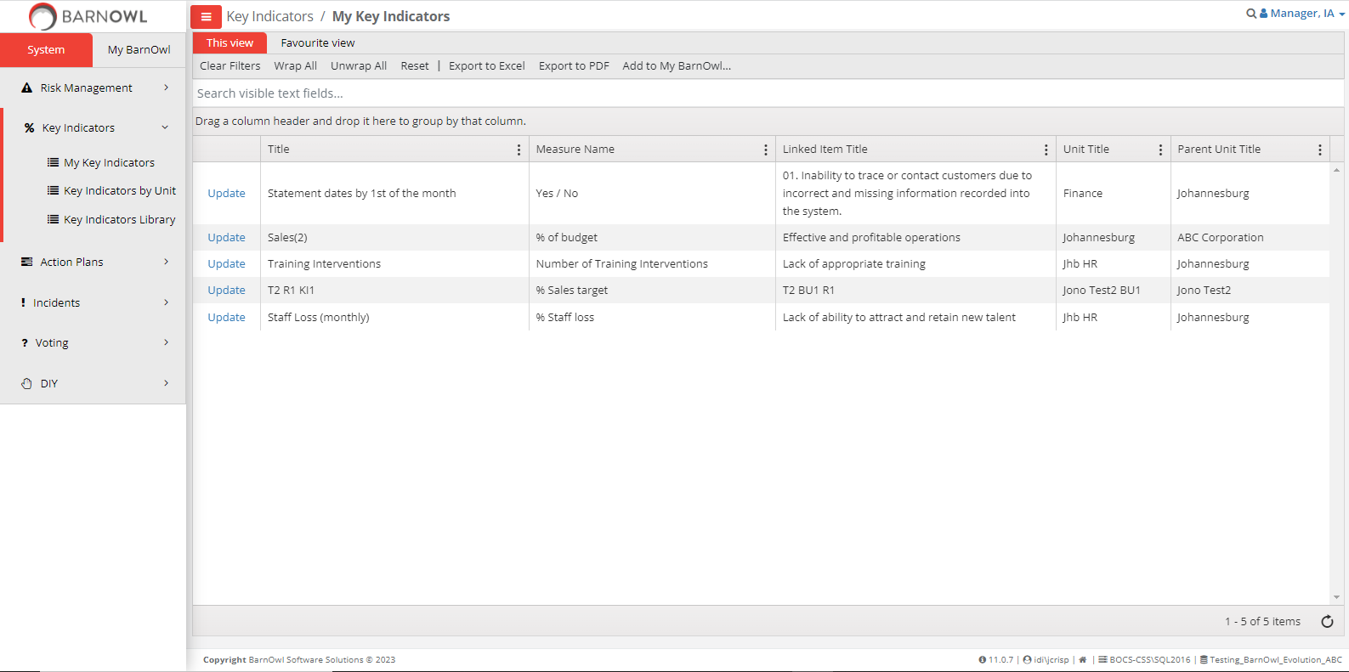
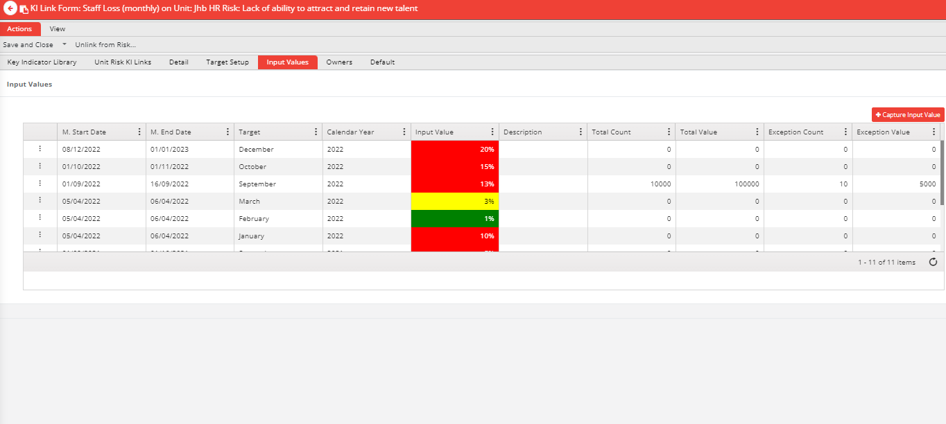
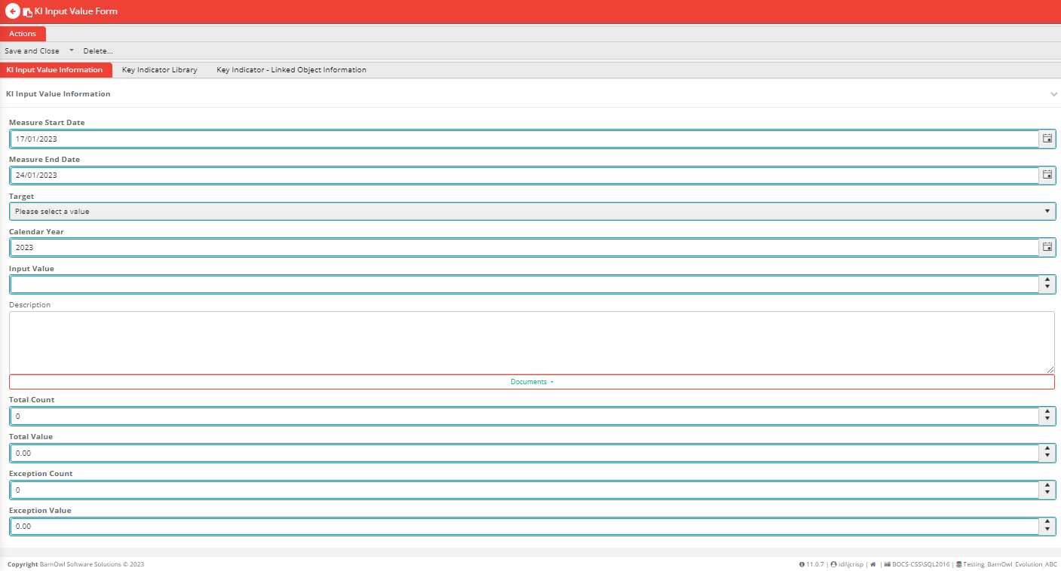
My Key Indicators

Slide 17
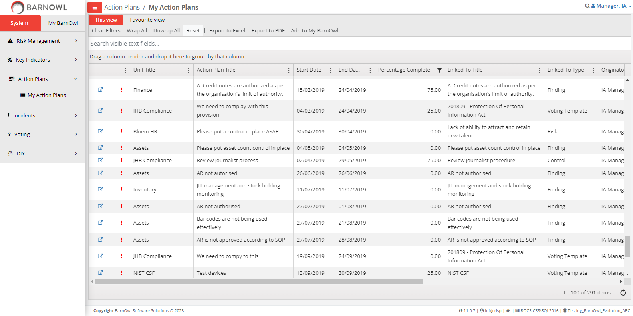
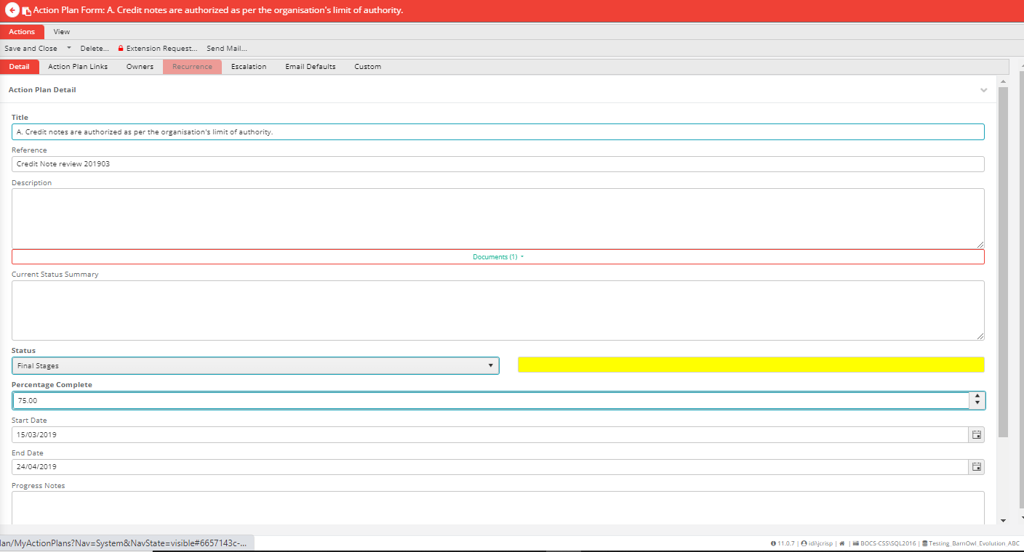
My Action Plans

Slide 18
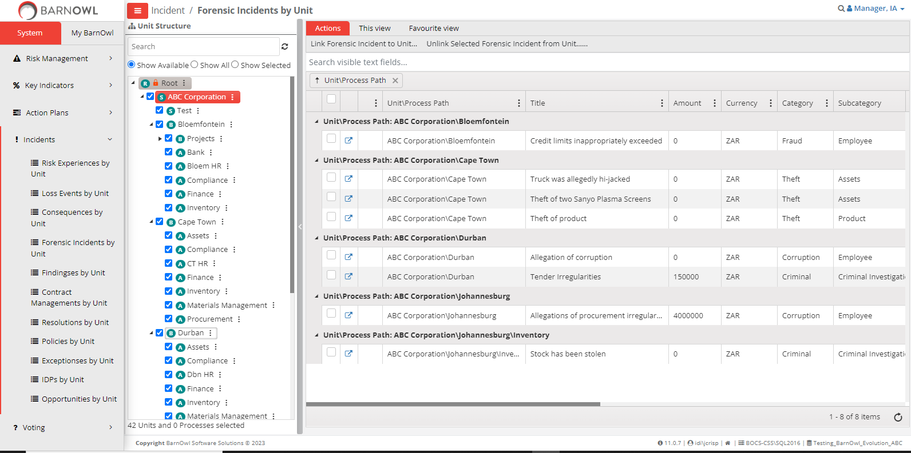
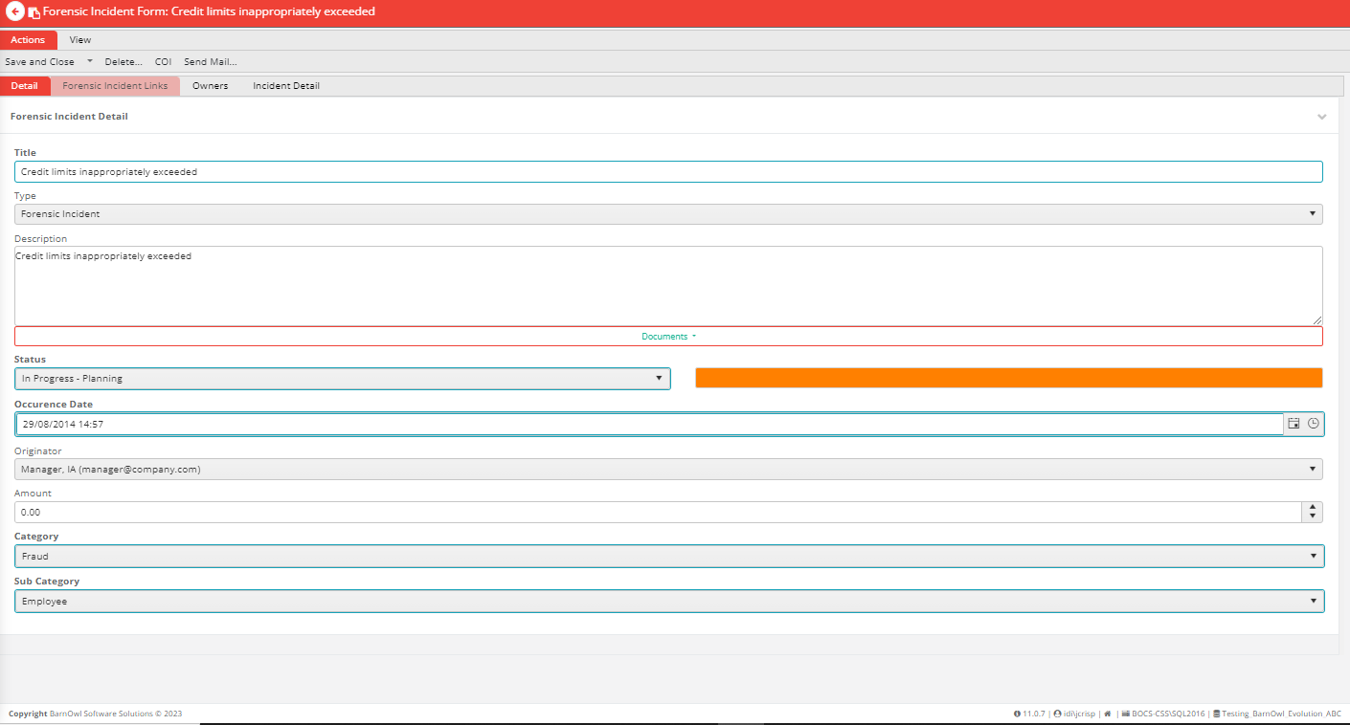
Incidents

Slide 19
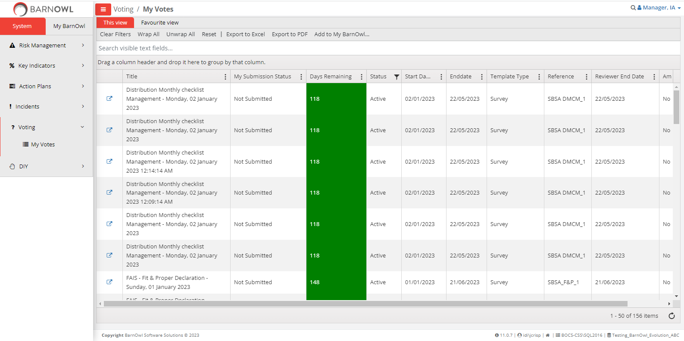
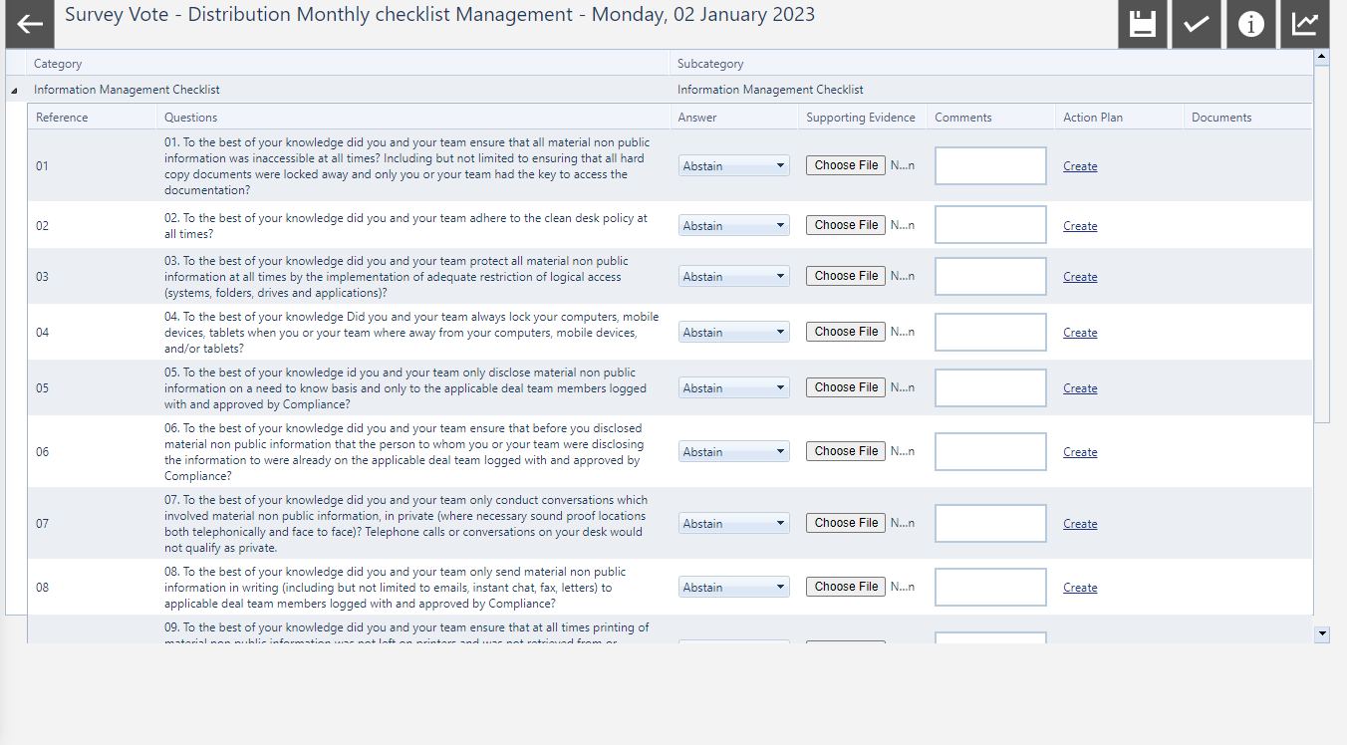
My Votes (v11.2 still to come)

Slide 20
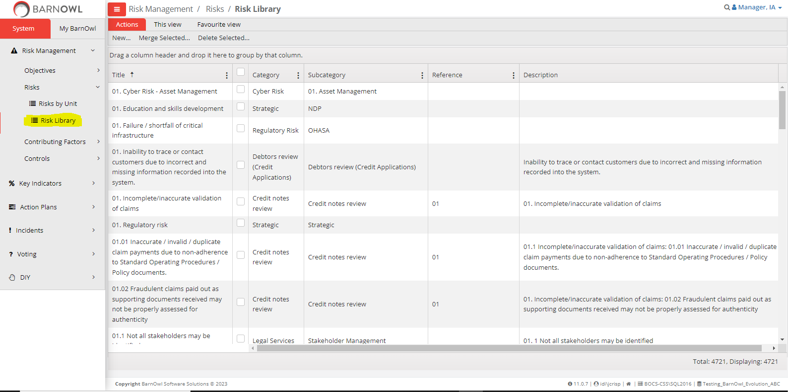
Library maintenance (v10) (v11.1 global search on visible columns)

Slide 21
Summary
Modern look & feel: easy and familiar to use
Easy navigation: embed risk management
Risk on a page: manage your risks in a simple and structured way
Performance: great performance over WAN / VPN
Enhanced functionality: custom field documents, action plan linked object, search visible fields etc.
State of the art web-based technology: take advantage of leading edge technology

Slide 22
Thank You
+27 11 540 9100 (office)
support@barnowl.co.za
+27 11 540 9112 (help desk)
http://www.barnowl.co.za/knowledge-centre/

